Slide 1
Flight delay analysis
Springboard bootcamp project unit 20.3.2
Prepared by Mike (Xiangnan) Shi

Slide 2
Outline
Data overview
Delayed flights vs On schedule flights
Delayed flight pattern by factors
Time of day
Month of year
Carriers
Airport
Summary

Slide 3
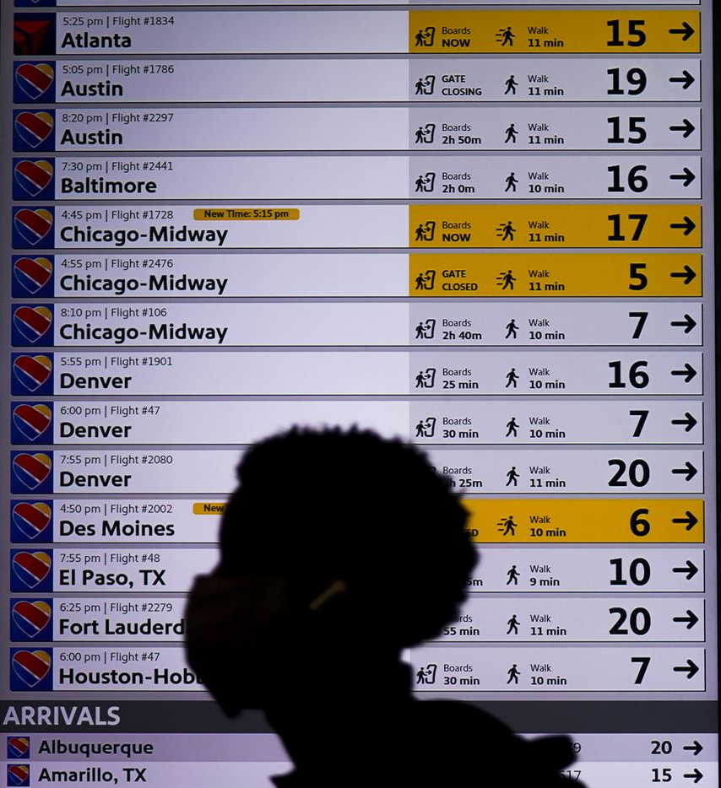
Data overview
Source: The data set comes from a Kaggle competition for flight delay predictions¹.
The dataset has 100,000 flight entries with details including:
Month
Day of month
Day of week
Departing time
Carrier
Origin
Destination
Distance
Whether or not it’s delayed for more than 15 minutes
1 data link: https://www.kaggle.com/c/flight-delays-spring-2018/data

Slide 4
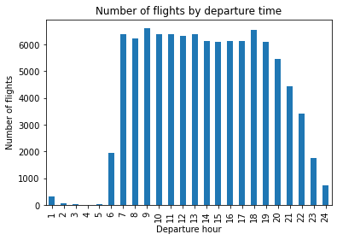
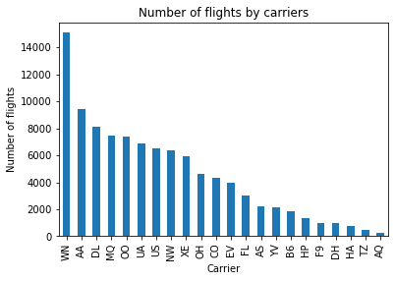
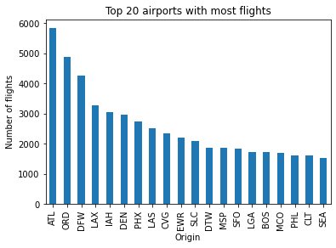
Data overview
Most of flights depart during the day time.
In our dataset, Southwest (WN), American Airlines (AA) and Delta (DL) operates the most flights .
The dataset has data from 289 airports. Among those Atlanta (ATL), Chicago (ORD) and Dallas (DFW) are the busiest airports.

Slide 5
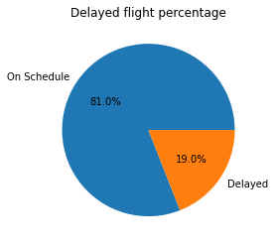
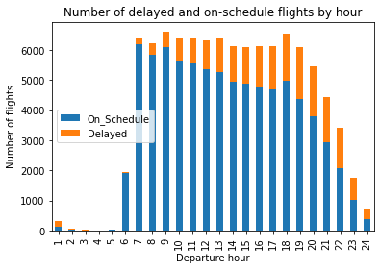
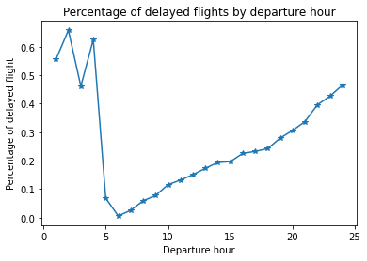
Delayed flights vs On schedule flights
19% of flights are delayed by at least 15 minutes.
An increasing number of flights tend to get delayed as the departure time gets later and later.
The percentage of delayed flights is very low starting at 5 AM, but starts increasing over time and reaches the peak after mid-night.

Slide 6
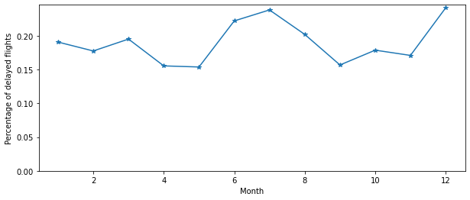
Flight delays in different months
June, July and December show the highest percentage of flight delays.
April, May and September show the lowest percentage of flight delays.

Slide 7
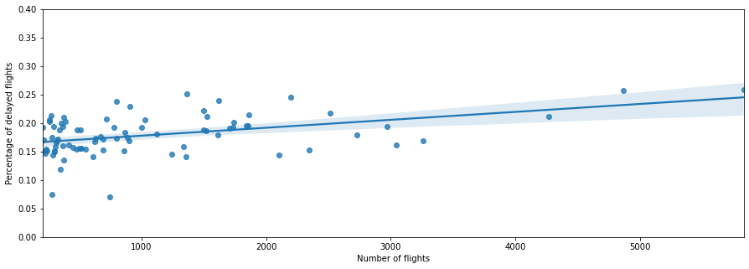
Flight delays vs airport capacity
The chart below shows the chance of flight delay and airport capacity for those airports that at least depart 200 flights.
There appears to be a slight upward trend, which means a bigger airport tend to have a higher percentage of flight delays.

Slide 8
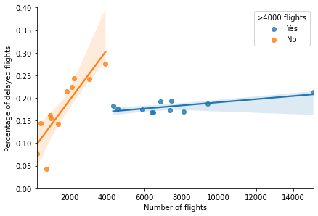
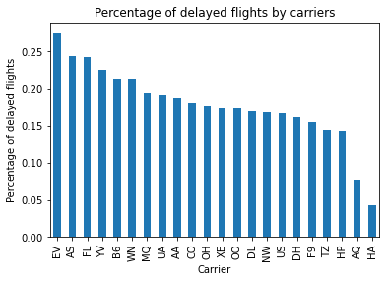
Flight delays vs Carrier capacity
ExpressJet (EV) and Alaska Airlines (AS) show the highest percentage of flight delays while Hawaiian Airlines (HA) and 9 Air (AQ) show the lowest.
There seems to be a trend between carrier capacity and percentage of flight delays. The trend is more obvious among big carriers (>4000 flights) than smaller ones.

Slide 9
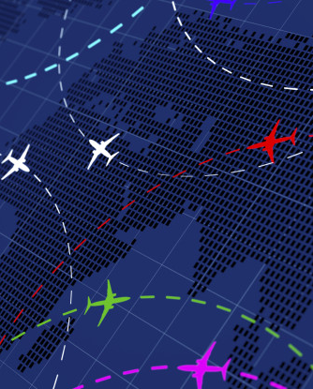
Summary
The average percentage of flight delays is 19%. However, this chance varies based on multiple factors.
A flight at a later time in the day tend to have a higher chance of delay than an earlier time.
Summer time and December tend to have higher chance of flight delays.
Airport capacity and carrier capacity may have slight impact on flight delay likelihood.

